Slide 1
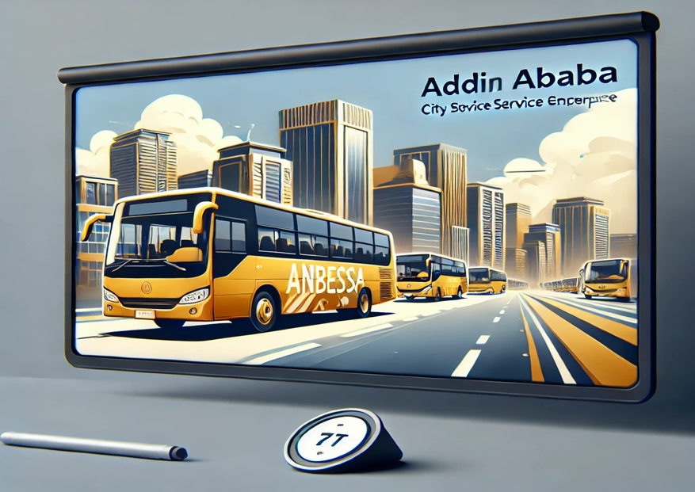
Modeling and Analysis of Bus Scheduling Systems of Urban Public Bus Transport
DAMO-610-2: Operations Analytics
Tisan Yakubu, John
Poojitha, Kanagala
Emmanuel, Olajubu
Ingrid Mogollon Vargas

Slide 2
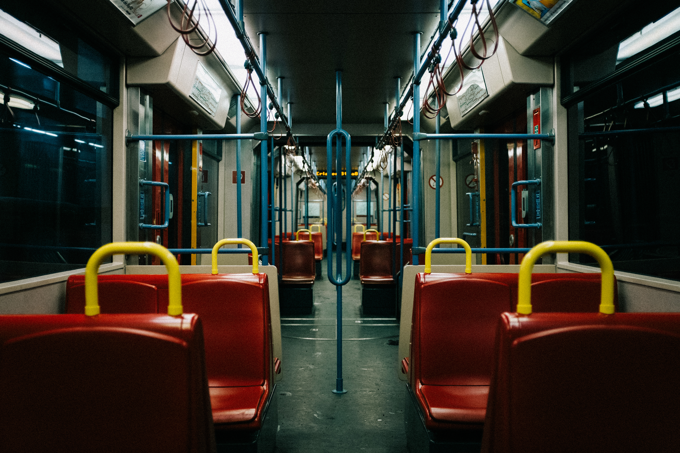

Anbessa City Bus Service Enterprise (ACBSE)
o1.
Introduction
o2.
Problem Definition
o3.
Review of the problem and Mathematical Modeling
o4.
Model Formulation
o5.
Extending the Mathematical Model
o6.
Reference

Slide 3
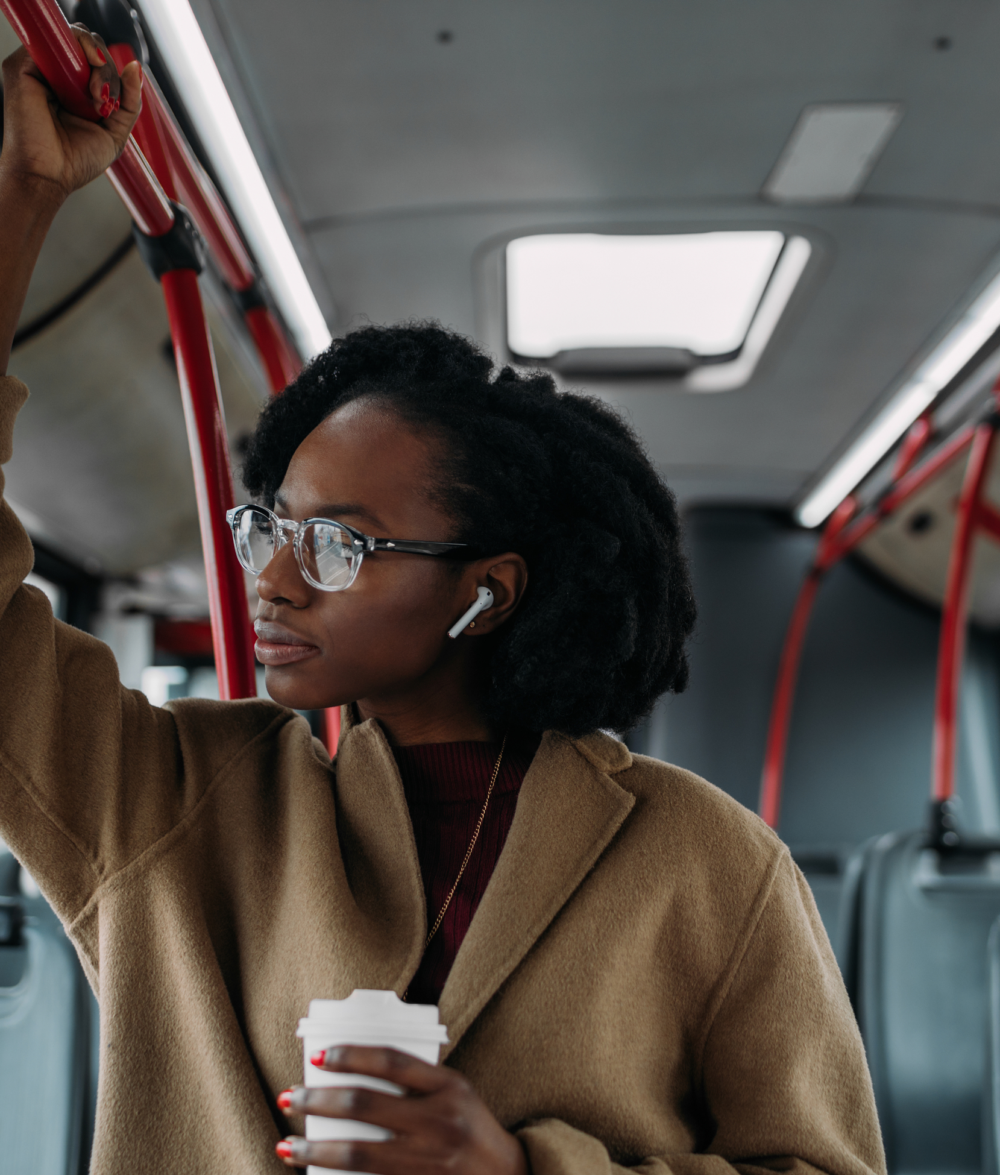
Anbessa City Bus Service Enterprise (ACBSE)
key public transport operator
It has 110 routes in this city, Ethiopia
faces many challenges that affect its operational efficiency
+3.2 million residents in Addis Ababa

Slide 4
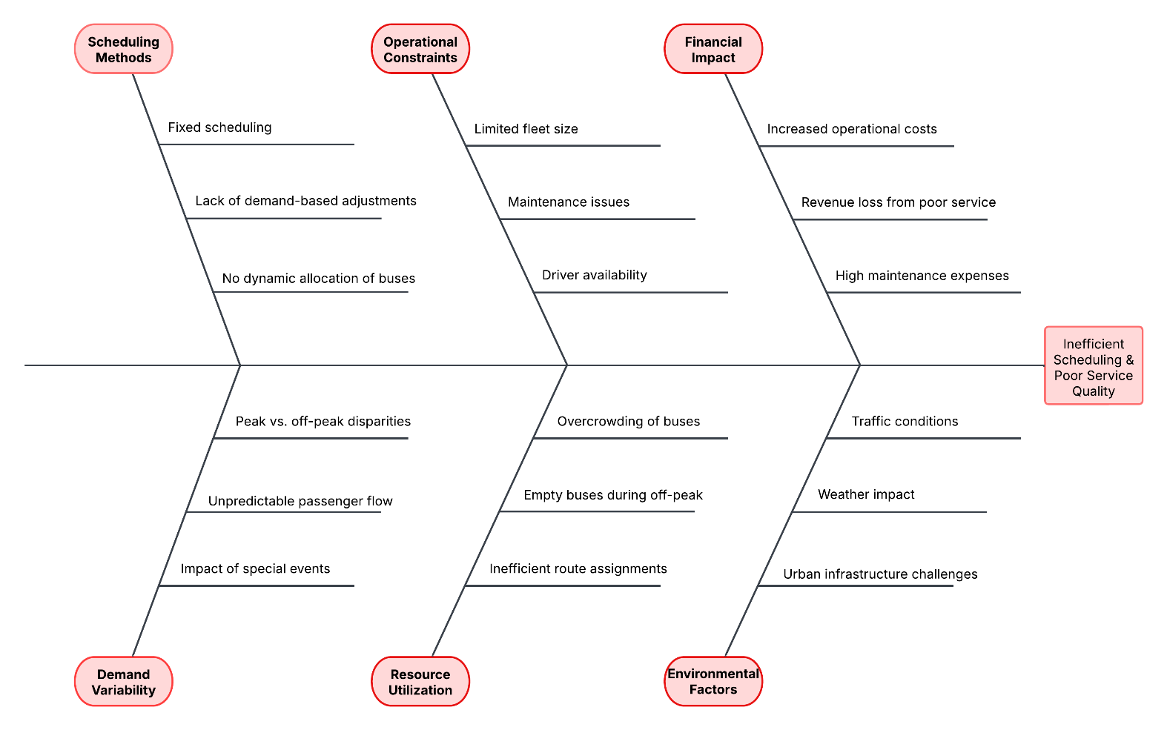
Problem Definition
Cause-and-Effect Ishikawa Diagram

Slide 5
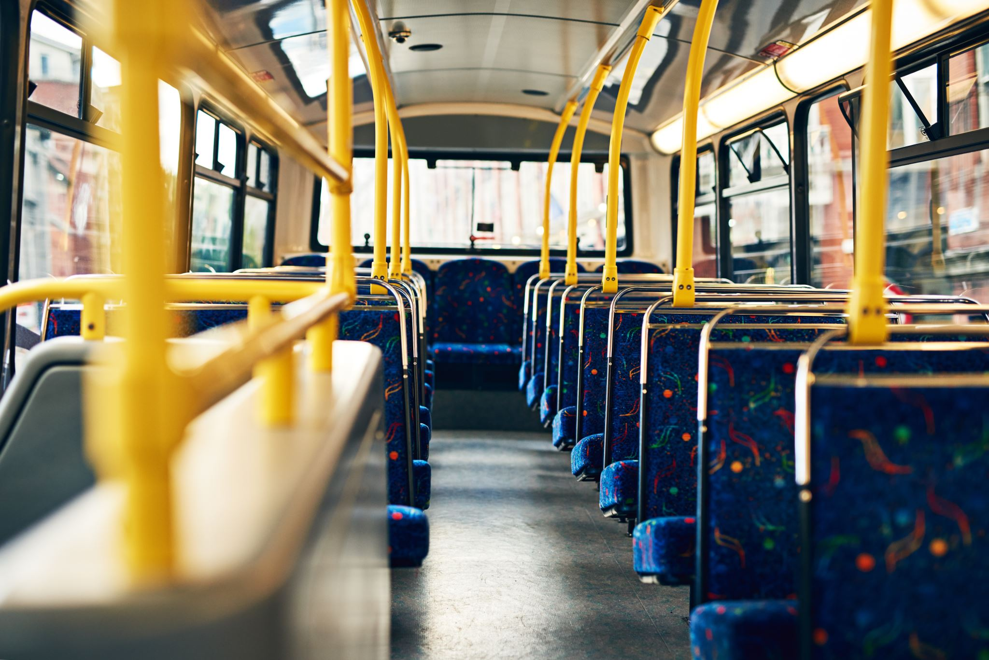
Review of the Problem and Mathematical Modeling
Addresses the inefficiencies in ACBSE's scheduling system by developing an LP model to optimize bus assignments across 93 routes
Bus Type-I (30 seats, total capacity of 60 passengers) with a fleet of 600
Bus Type-II (45 seats, total capacity of 90 passengers) with a fleet of 90
The model was solved using GAMS, and the results showed significant improvements:
Bus utilization increased from 64.26% to 66.33%.
Operating costs decreased by 13.74% (from 1,101,283.68 ETB to 949,991.49 ETB).
Total distance covered reduced by 10.13% (from 78,964 km to 70,964 km).

Slide 6

Review of the Problem and Mathematical Modeling
The previous study assigned a larger fleet to Type-I buses (600 units) and a smaller fleet to Type-II buses (90 units)
Type-II buses have a higher capacity (90 passengers vs. 60 passengers)
It has restructured the fleet by increasing Type-II buses and decreasing Type-I buses.
This model optimizes the assignment of buses across 93 routes and 4 shifts, ensuring demand is met while minimizing operational costs and trip redundancy.

Slide 7
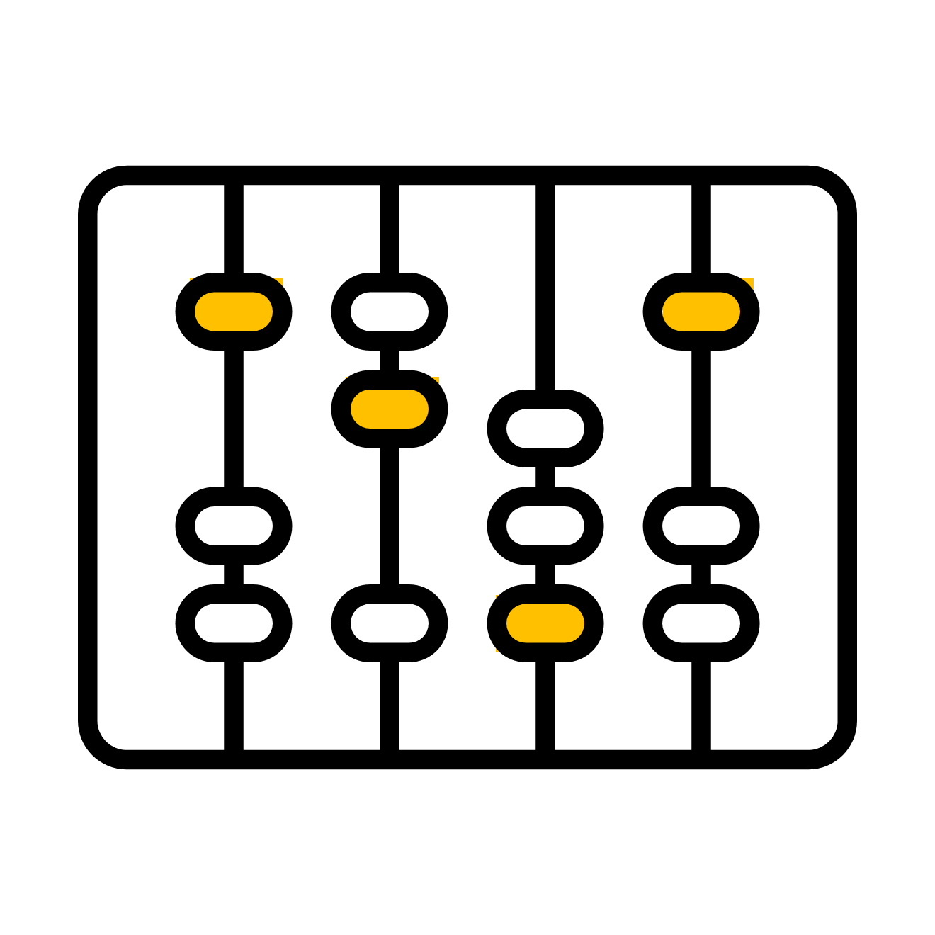
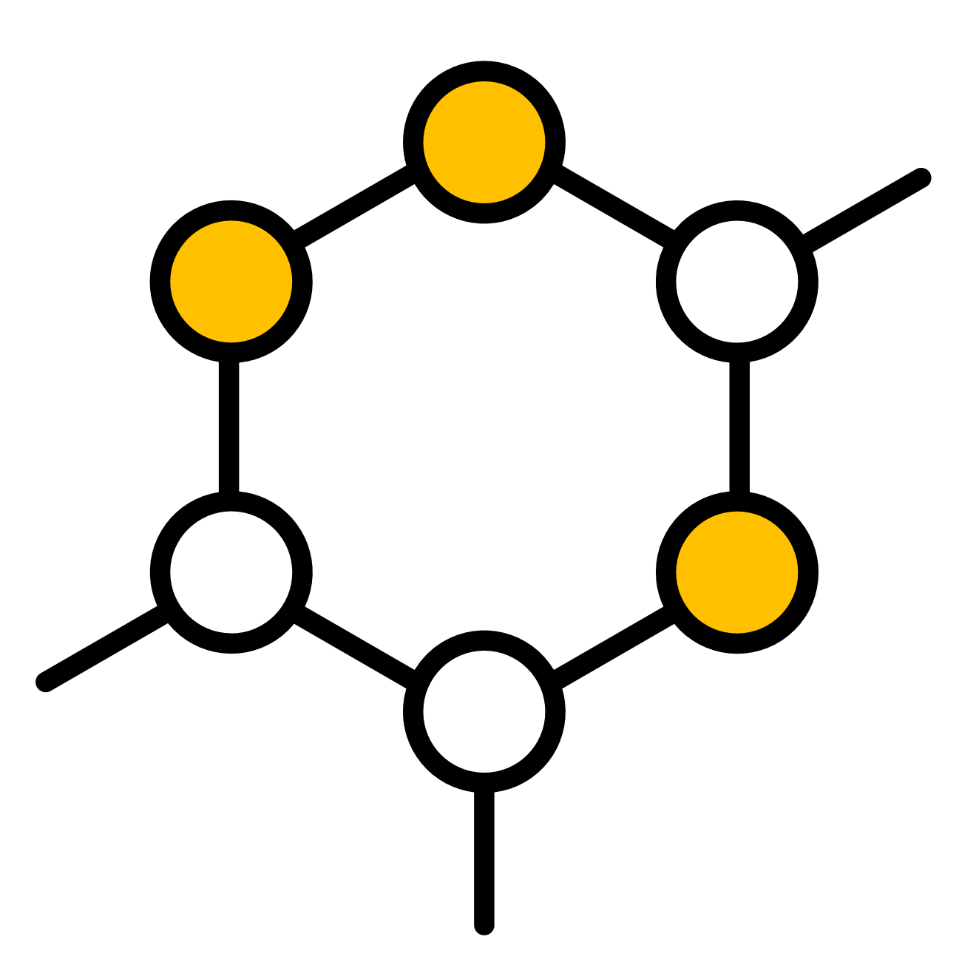

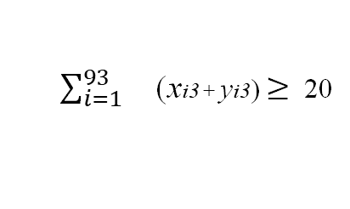
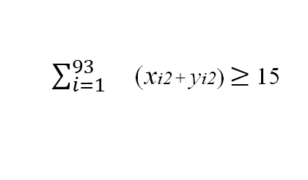
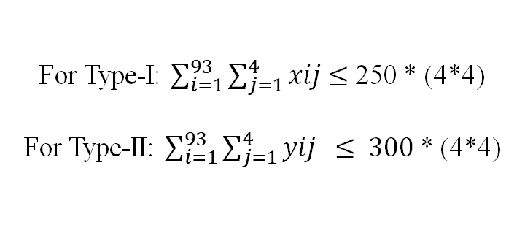
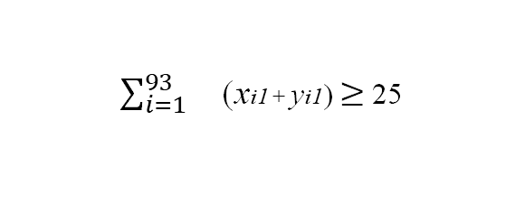
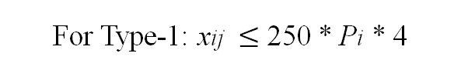
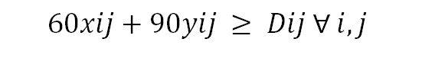

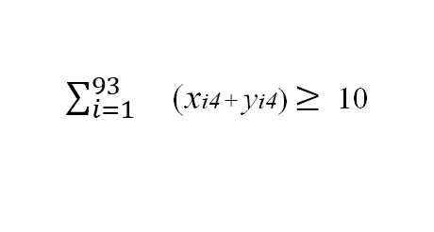
Model Formulation
xij : Number of trips by Bus Type-I on route iii during shift j.
yij: Number of trips by Bus Type-II on route iii during shift j.
Constraints
min$\sum_{i=1}^{93}{\sum_{j=1}^{4}{\left(xij+yij\right)}}$
Fleet Size Constraints
Minimum Trips Constraints
Demand Satisfaction
$\sum_{i=1}^{93}{}$(xi1 + yi1) $≥$ 25
$\sum_{i=1}^{93}{}$(xi2 + yi2) $≥$ 15
For Type-I: $\sum_{i=1}^{93}{\sum_{j=1}^{4}{xij}}$ $≤$ 250 * (4*4)
For Type-II: $\sum_{i=1}^{93}{\sum_{j=1}^{4}{yij}} ≤ 300$* (4*4)
$\sum_{i=1}^{93}{}$(xi3 + yi3) $≥$ 20
$$60xij+90yij ≥ Dij ∀ i,j$$
$\sum_{i=1}^{93}{}$(xi4 + yi4) $≥$ 10
Trip Limit Constraints
Non-Negativity
For Type-1: xij $≤$ 250 * Pi * 4
xij, yij ≥ 0
For Type-II: yij ≤ 300 * Pi * 4

Slide 8
Implementation using Python and Google OR-Tools
Step1: Import required libraries
Step7:Define the constraints:
Step4: Initialize of declare the solver required
Demand constraints
Fleet size constraints
Minimum trip constraints for each shift
Trip limit constraints for route balancing
Step2: Define new data and generate realistic demand per route per shift (based on past LP model)
Step5: Create decision variables for bus allocation
Step3: Calculate trip proportions and set minimum trips per shift based on schedule
Step6: Define the objective function: Minimize total trips
Step8: Invoke the Solver
Step9: Print solution with structured explanation

Slide 9
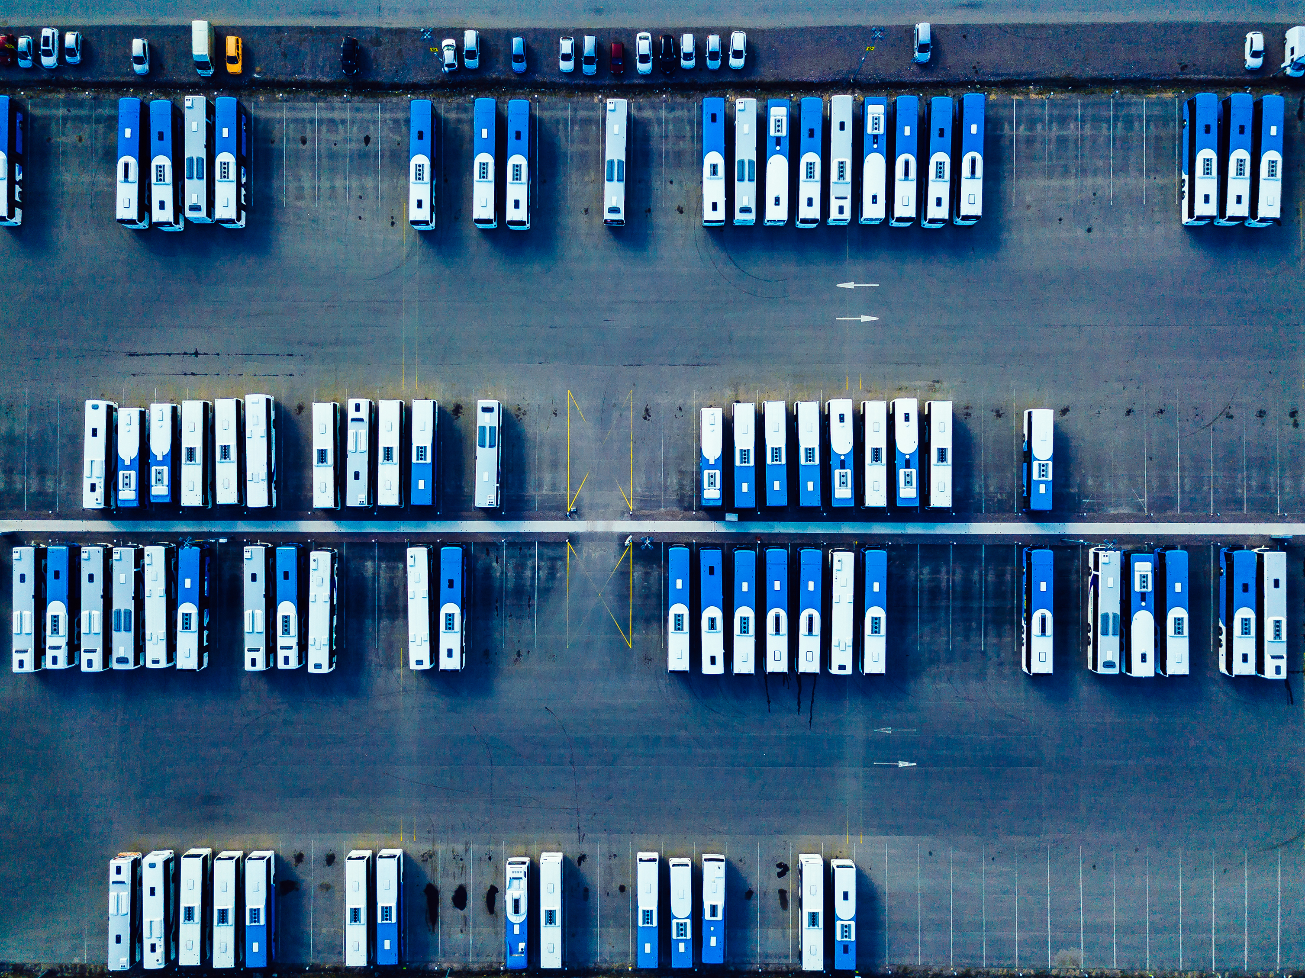
Results
Total Type-I bus trips used: 4 and Total Type-II bus trips used: 2304
Type-I buses were allocated in high-demand areas.
Type-II buses (higher capacity) were used for efficiency in major demand shifts.
Model effectively minimized trips while meeting demand constraints.
Demand is evenly distributed across shifts, avoiding congestion.
All fleet size and operational constraints were successfully met.

Slide 10
Extending the Mathematical Model
Using real-time data for smarter scheduling
Instead of relying only on historical demand, our model should take real-time passenger trends into accounts.
Balancing Multiples Priorities
Public transit isn't just about minizine costs-it's also about keeping passengers happy. By optimizing for both cost efficiency and passenger convenience, it can ensure a well-balanced solution.
Making the Model More Eco-Friendly
Public transportation plays a key role in reducing carbon emissions, and our model should reflect that. By prioritizing low-emission buses and optimizing routes to reduce fuel consumption, it can make scheduling more sustainable.
Factoring in Unpredictable Demand
Demand for buses isn’t always predictable. By incorporating probability-based constraints, our model can handle fluctuations and unexpected surges more effectively.

Slide 11
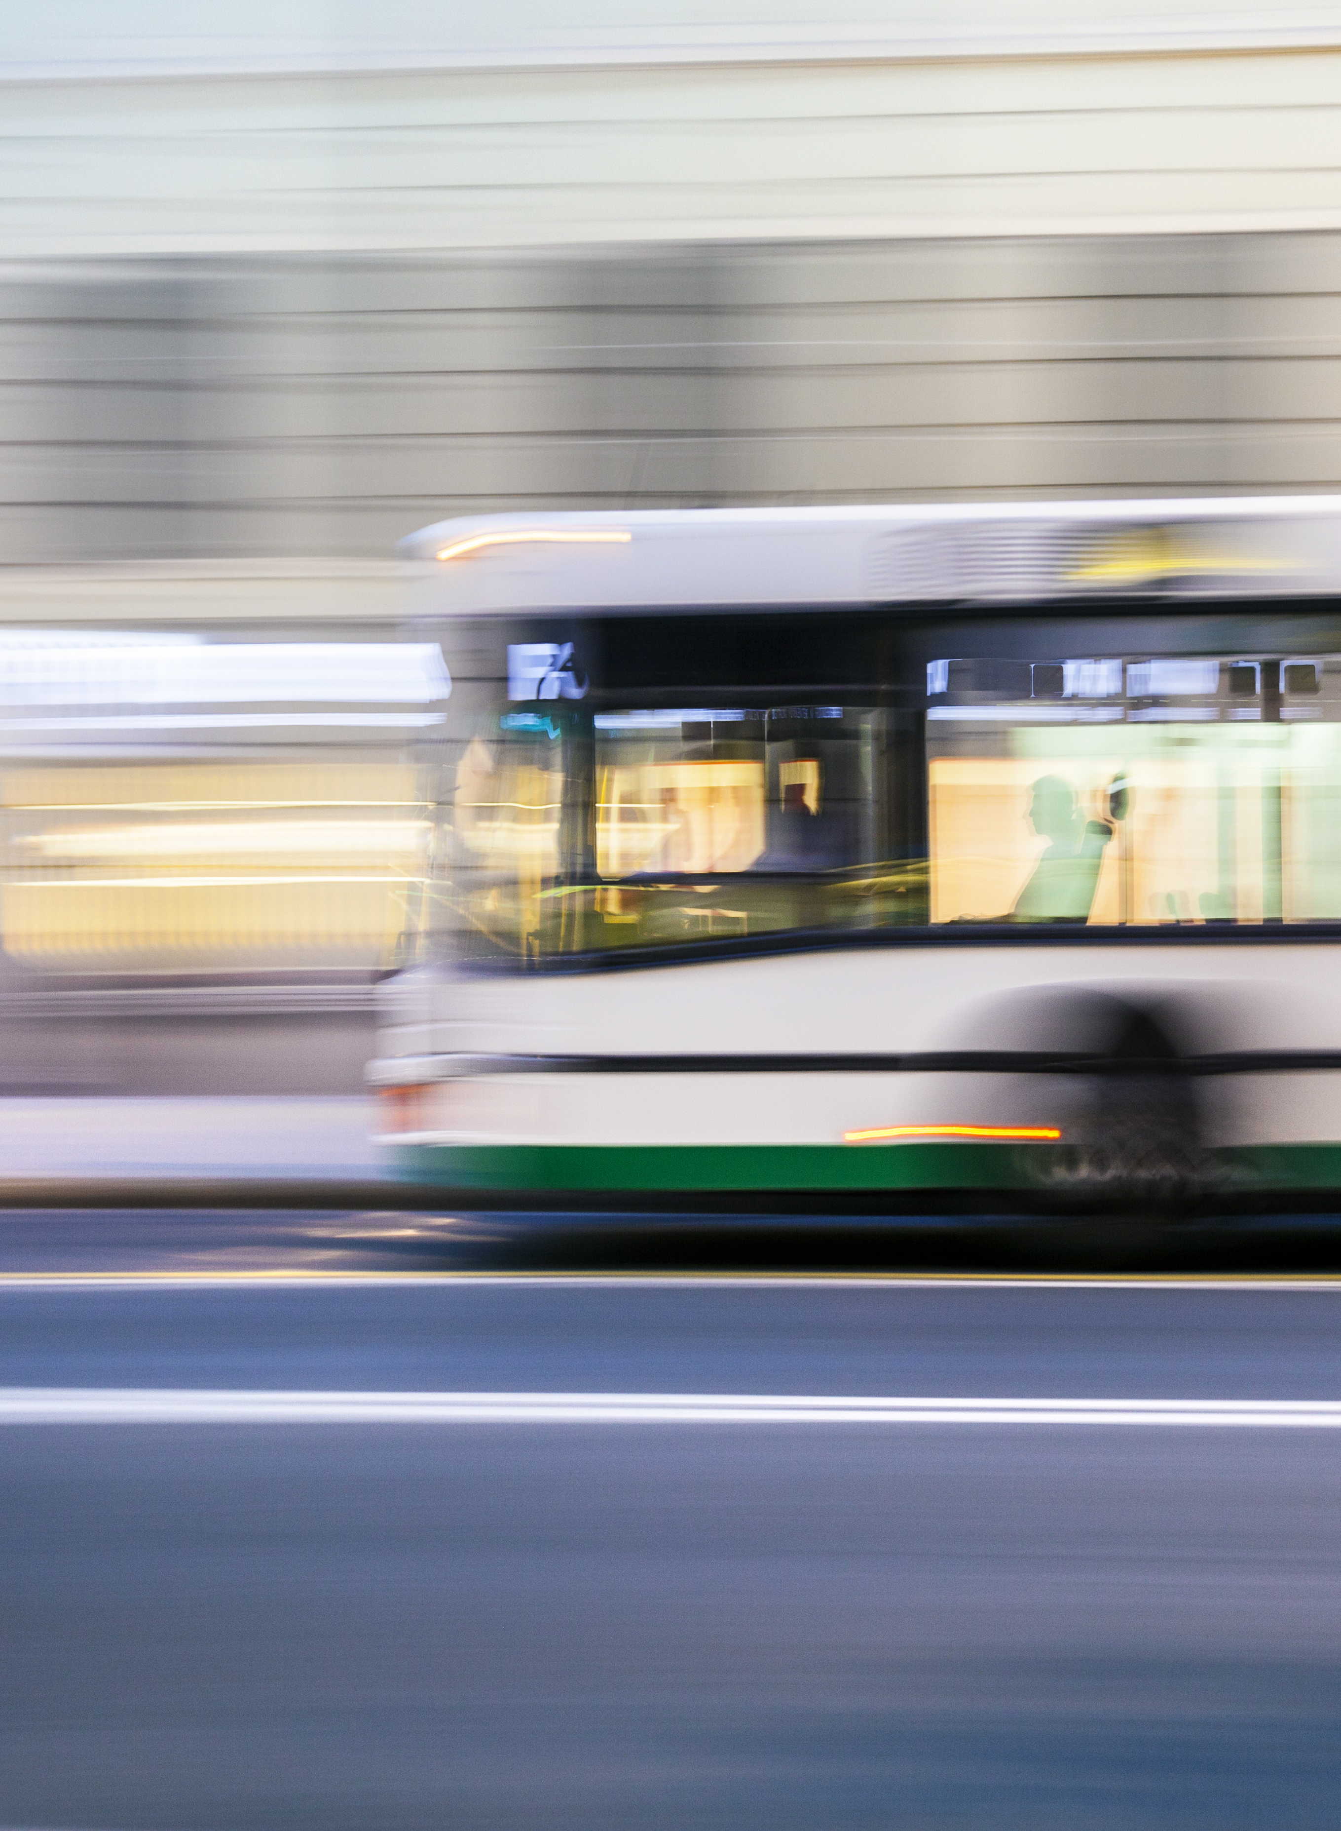
What It’s Optimizing
x(ij): Number of trips made by Bus Type-I on route (i) during shift j
y(ij): Number of trips made by Bus Type-II on route (i) during shift j
d(ij) Adjustment factor for real-time demand on route (i) during shift j
e(ij): CO2 emissions from buses on route (i) during shift (j)

Slide 12
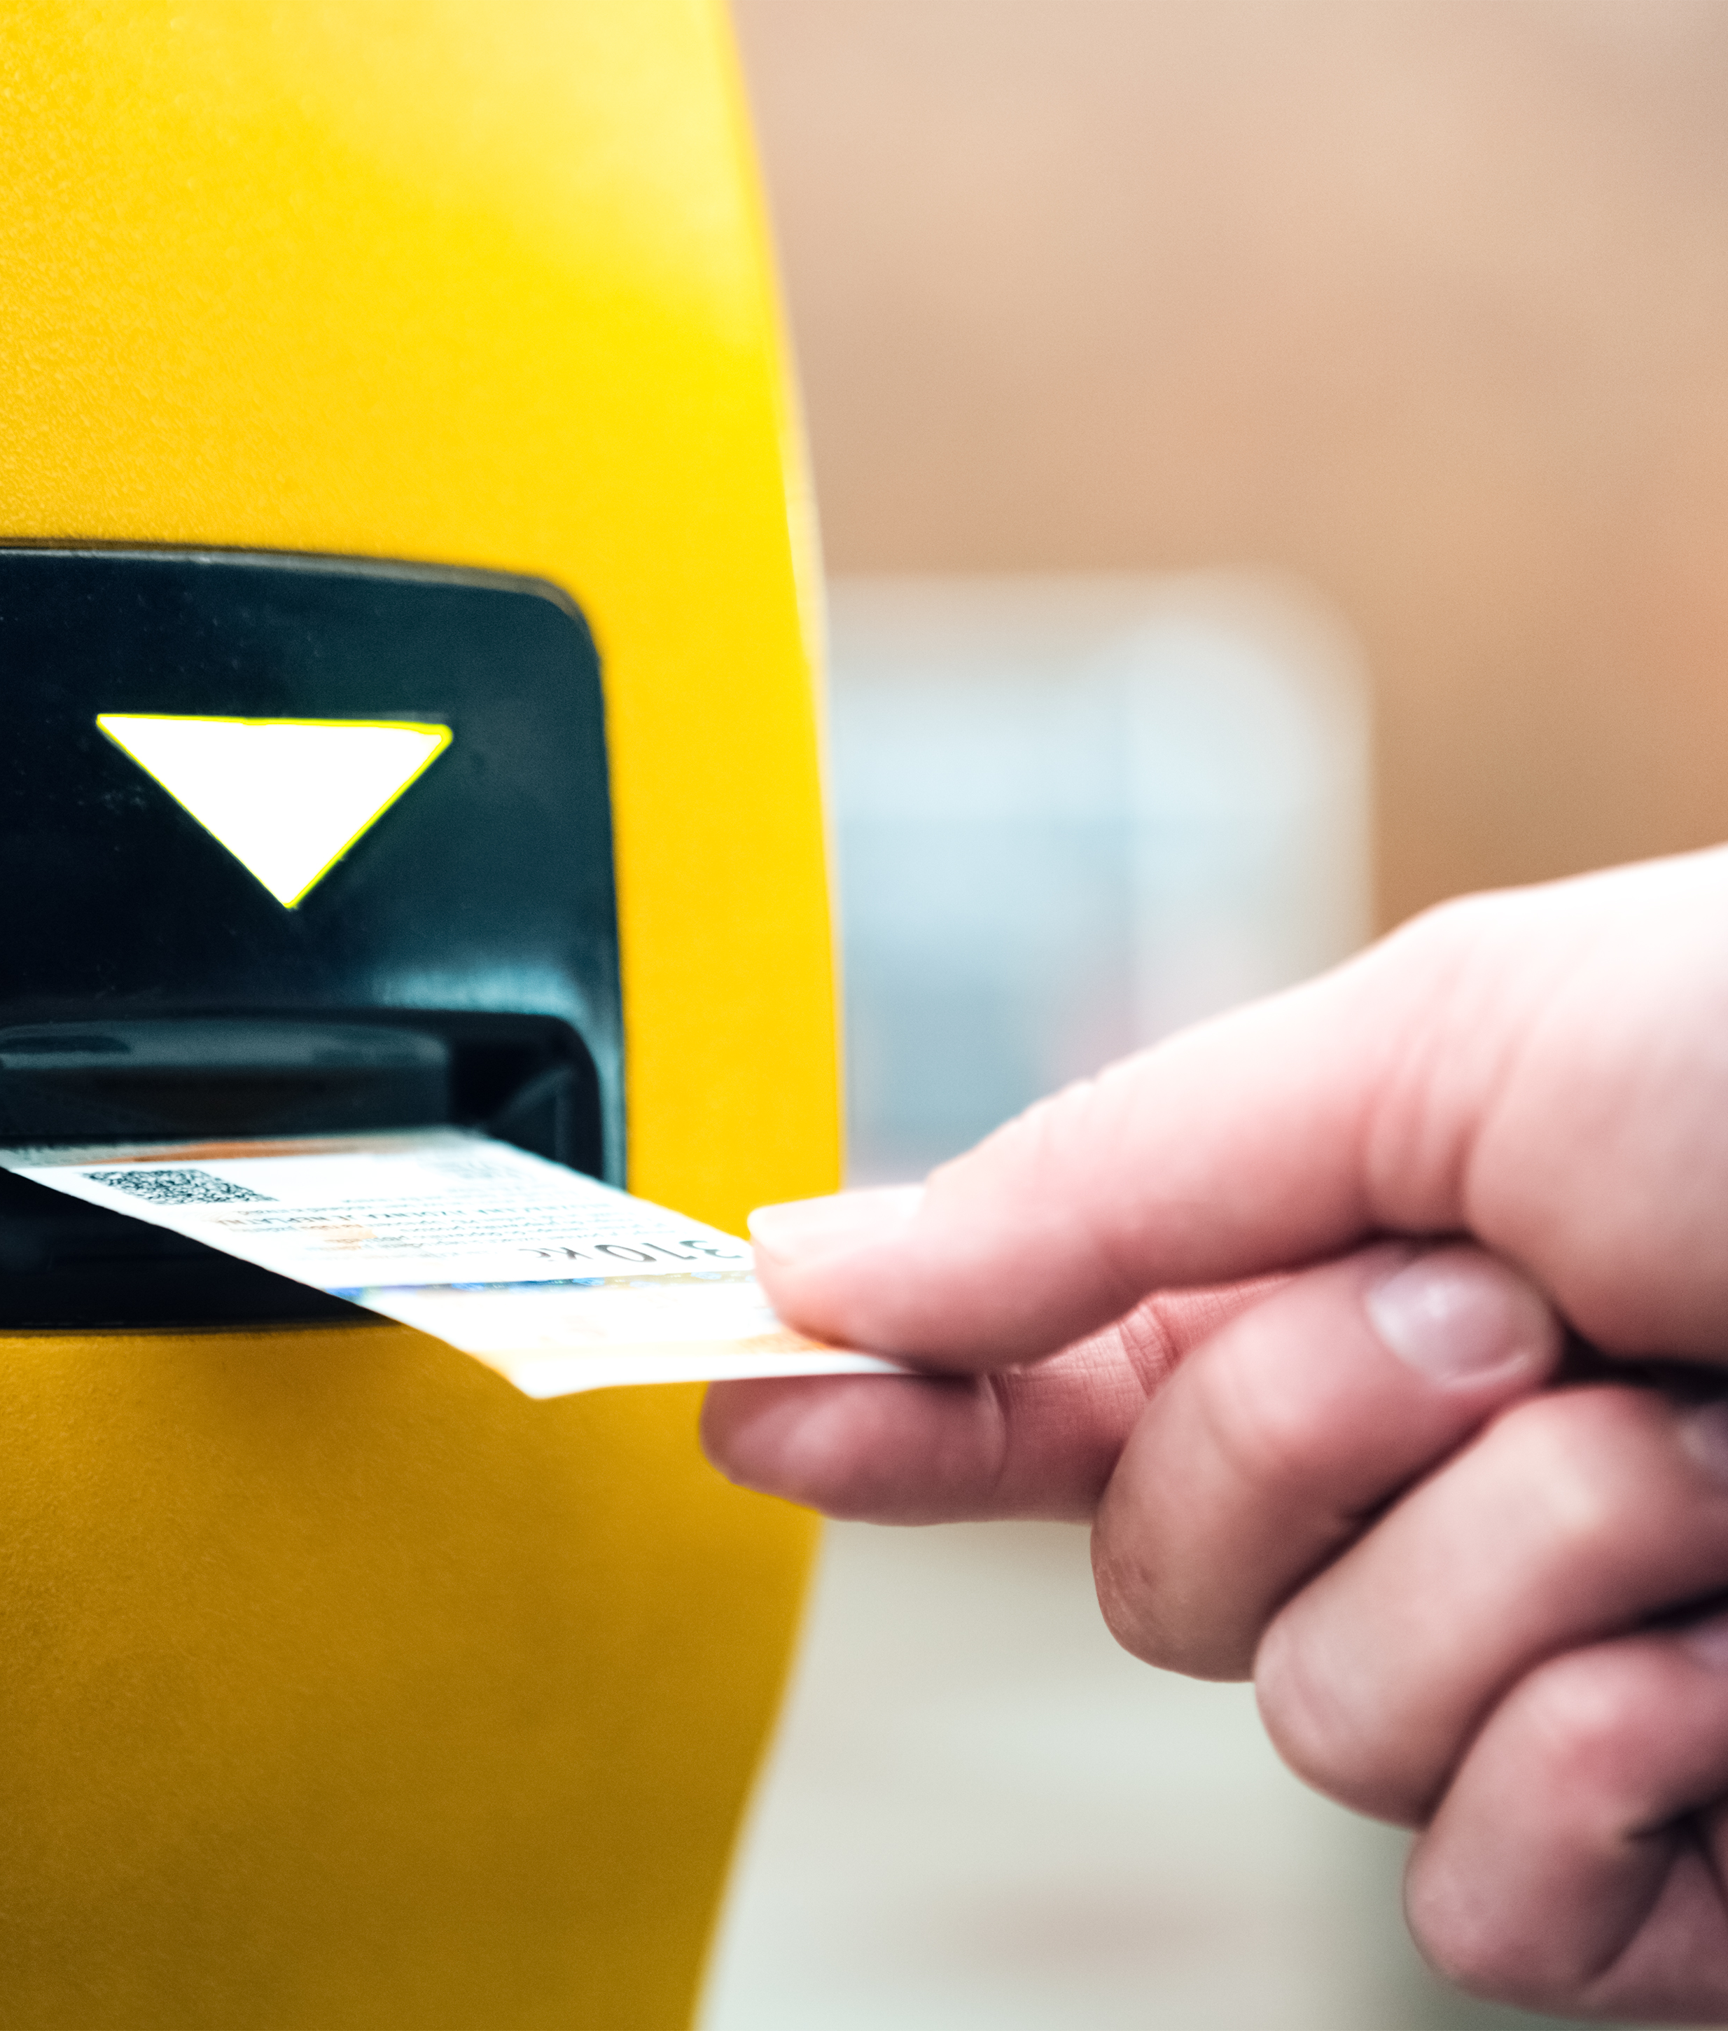
w: Passenger waiting time on route (i) during shift (j)
The model result states, "Total Type-I bus trips used: 4" and "Total Type-II bus trips used: 2304". If Type-I buses were still part of the fleet (250 buses), why were they only used 4 times?
This suggests that Type-I buses are underutilized and could either be further reduced or removed entirely if they serve no purpose.

Slide 13
Conclusion
These refinements make our model more, it makes it more responsive, efficient, and practical for real-world use. With real-time data integration, the model can adapt dynamically to passenger needs, reducing delays and optimizing routes.
Beyond improving day-to-day transit efficiency, this model provides a strategic foundation for urban transportation planning. By balancing cost reduction with service quality, it ensures reliability for passengers while optimizing resource allocation for transit operators

Slide 14
Reference
Johnson, M., & Lee, S. (2023). Lean thinking in public transportation: A case study on Takt Time implementation. Journal of Transportation Efficiency, 12(3), 145- 160. https://www.sciencedirect.com/science/article/pii/S0925527319301234
Kumar, R., & Singh, P. (2023). A study of customer satisfaction in public transportation system. International Journal of Research in Engineering and Science, 11(5), 207 -210. https://www.ijres.org/papers/Volume-11/Issue-5/1105207210.pdf
Smith, J., & Brown, A. (2023). Resource allocation and strategy. Journal of Business anagement, 39(4), 567-589. https://journals.sagepub.com/doi/pdf/10.1177/0149206317729738
Zhang X, Lauber L, Liu H, Shi J, Xie M, Pan Y (2022) Travel time prediction of urban public transportation based on detection of single routes. PLoS ONE 17(1): e0262535. https://doi.org/10.1371/journal.pone.02625
Zhang, Y., & Liu, X. (2023). Integrated public transport timetable synchronization and vehicle scheduling with demand assignment: A bi-objective bi-level model using deficit function approach. Journal of Transportation Research, 45(2), 123-145. https://www.academia.edu/103745891/Integrated_public_transport_timetable_synchronization_and_vehicle_scheduling_with_demand_assignment A_bi_objective_bi_level_model_using_deficit_function_approach

Slide 15
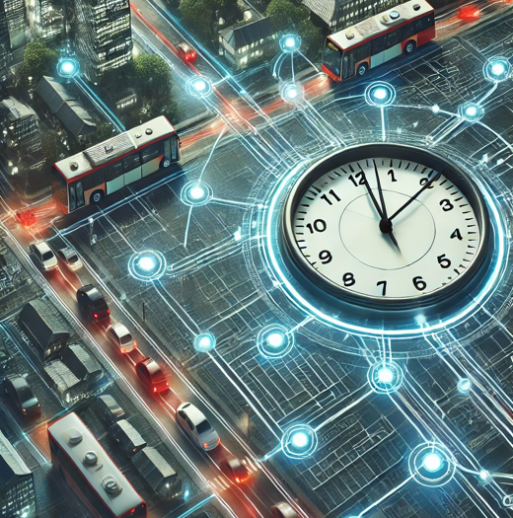
Thank you

